Slide 1
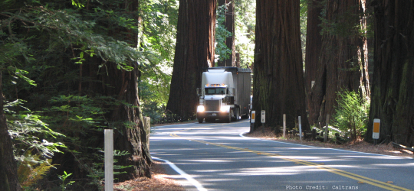
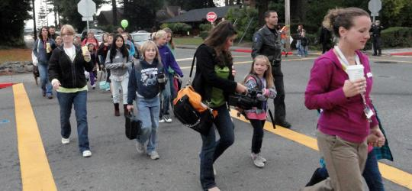
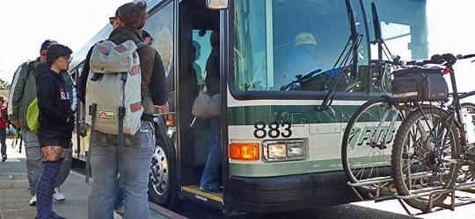


Humboldt County Association of Governments
Board Orientation
Presented by: Beth Burks, HCAOG Executive Director

Slide 2
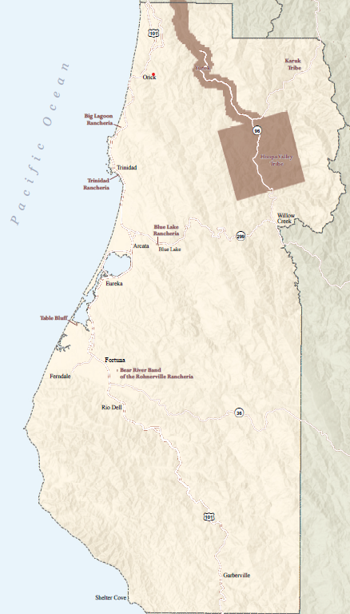
What is HCAOG?
It is the designated Regional Transportation Planning Agency.
HCAOG is a Joint Powers Agency
  Board Meets 3rd Thursdays, City of Eureka Chambers at 4PM
Technical Advisory Council
  Meets first Thursdays at 2:30- HCAOG
Social Service Technical Advisory Council
  Meets Bi-monthly, First Wednesday at 1:30
Notes:
As RTPA HCAOG provides a forum to plan, discuss, and study transportation issues. HCAOG prepared and adopts the regional transportation plan among other documents and serves as the regional agency for local, state and federal transportation programs and funding opportunities.
Joint Powers Authority- We also have two committees that advise the Board
Technical Advisory Committee- made up of primarily the public works director from each of our member agencies, and unique to HCAOG we also have Several representatives from tribal governments who sit as voting members.
Social Service Advisory Council- Which focuses primarily on public transit related issues
We are focused on region wide planning issues related to active transportation, (pedestrian and cyclists, and making sure there is a strong and safe transportation network for them), public transit, and other transportation projects with region wide importance. An example of the biggest project HCAOG has been involved with is the Arcata Eureka Safety Corridor project which has been in the works since 2001 and is slated for construction beginning in 2022. This is an undercrossing at Indianola, and the Bay Trail has been funded in part by this project as well.

Slide 3
HCAOG: Origins
HCAOG was established on May 7, 1968, through a Joint Powers Agreement (JPA) signed by the seven incorporated cities and the unincorporated County.
Until 1972, HCAOG’s purpose was to coordinate planning efforts to “advise, plan for, and suggest solutions to common problems”.
The role was limited to projects that required coordinated review as a condition to securing federal or state funding.

Slide 4
HCAOG: Amendments to JPA
1972- HCAOG established as Regional Transportation Planning Agency (begins administering Transportation Development Act Funds
1975 and 1976- jurisdictions paid “dues” to hire staff.
1984 –changes to JPA to fund employees with State funding instead of grants and member dues, got powers to directly employ employees and prepare reports, surveys studies, accept gifts, loans and grants from public and private sources.
1993- became the Service Authority for Freeway Emergencies

Slide 5
HCAOG: Amendments to JPA
2010- Declaration of Purpose amended to include
  Association is to engage in
    Mandated State and Federal Government Activities (includes RHNA)
    Regional Transportation Planning Activities
    Service Authority for Freeway Emergencies
    Regional trails planning, management, and development
2016- HCAOG designated as the Local Transportation Authority- allowed HCAOG to impose sales tax county wide if ratified by voters. (Failed measure U)

Slide 6
HCAOG
Mission Statement
To develop, operate, and maintain a well-coordinated, balanced, countywide multimodal transportation system that is safe, efficient, and provides good access to all cities, communities, and recreational facilities, and into adjoining regions. A balanced multimodal transportation system includes but is not limited to a highway, public transit, aviation, marine, railroads, recreation, bicycle, pedestrian, and utility systems.

Slide 7


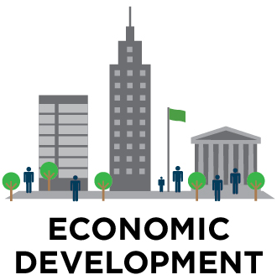
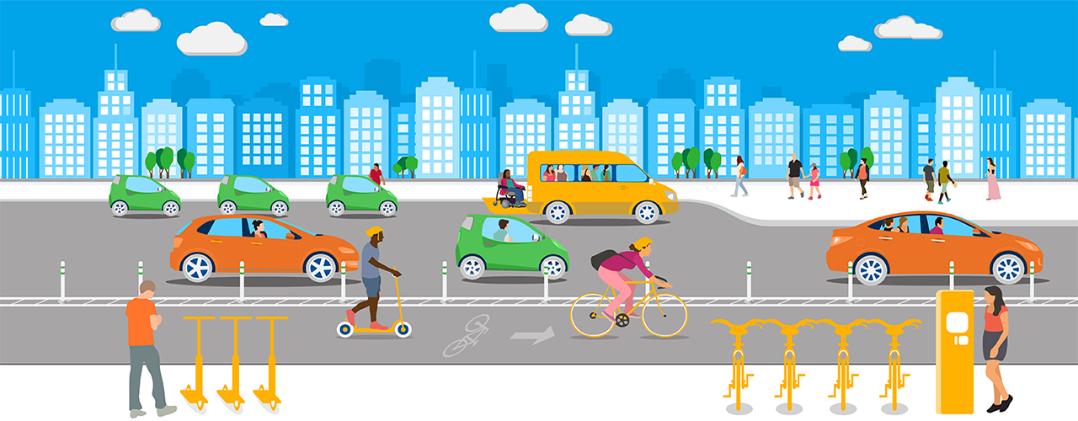
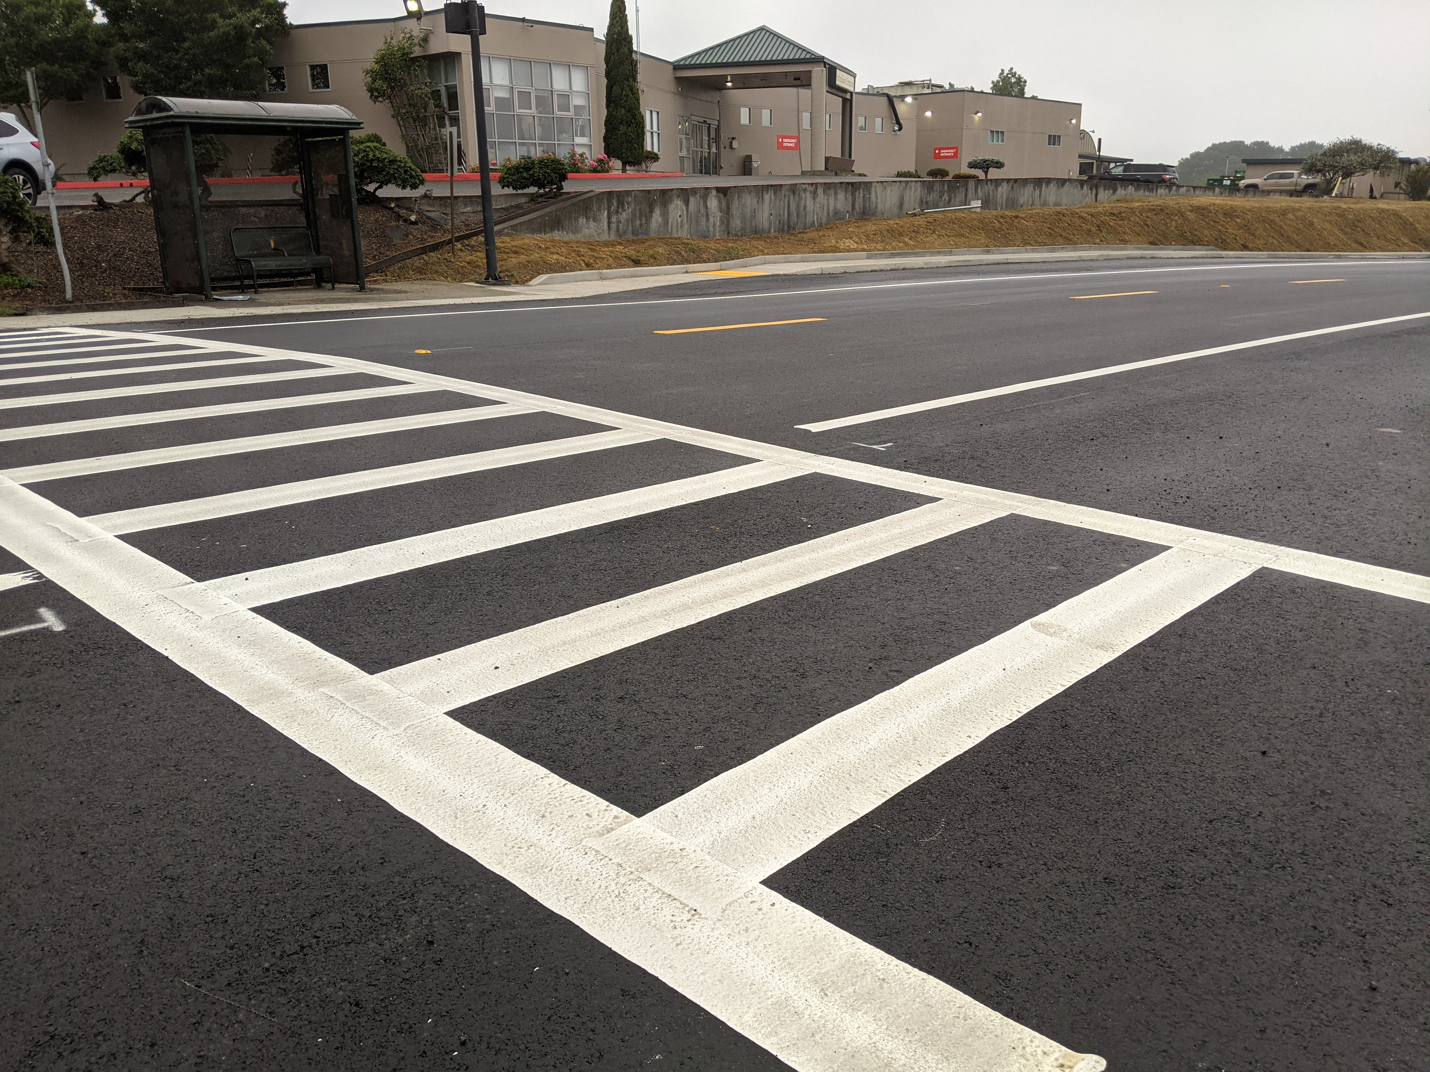

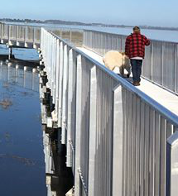
If you care about…
Notes:
Our region’s transportation infrastructure impacts every person who lives here, every visitor who travels here, and all the goods and services that make their way to us. It connects us all. In terms of dollars, the transportation system is our Community’s biggest infrastructure investment.
So if you care about any of these things you should care about the goings on at HCAOG, because transportation is related to all of these. Its how we get around, whether that be walking, biking, driving, how we move goods around, and how we build our communities to be safer and have better transportation options.
Transportation relates to all of these issues
ED
Equity
Jobs
Housing
Health
Better mobility options
The conditions of roads
Trails
Sea Level Rise
Our transportation system hugely impacts our quality of life and our health.

Slide 8
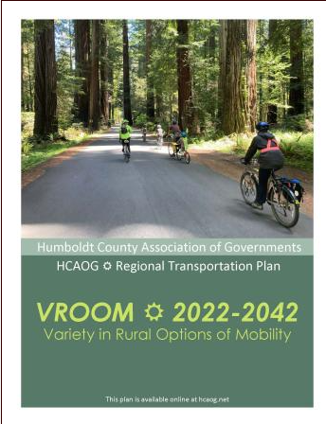


Required RTPA Duties/Role
Plans

Slide 9
Funding allocated by HCAOG
Local Transportation Fund (Allocated by population per TDA regulations)
2% Bicycle and Pedestrian Fund
State Transit Assistance Fund
State of Good Repair Program
Low Carbon Transit Operation Program
Federal Transit Administration 5311 Formula Grants for Rural Areas
Federal Transit Administration 5311f Intercity Bus Program
Regional Surface Transportation Program
Regional Transportation Improvement Program
Highway Infrastructure Program
One time funding sources
Grants
Notes:
$8-12 Million per year

Slide 10
2022 Transit Allocations $7.4M
Notes:
$8-12 Million per year

Slide 11
2022 Jurisdiction Allocations $2.3M
Notes:
$8-12 Million per year

Slide 12
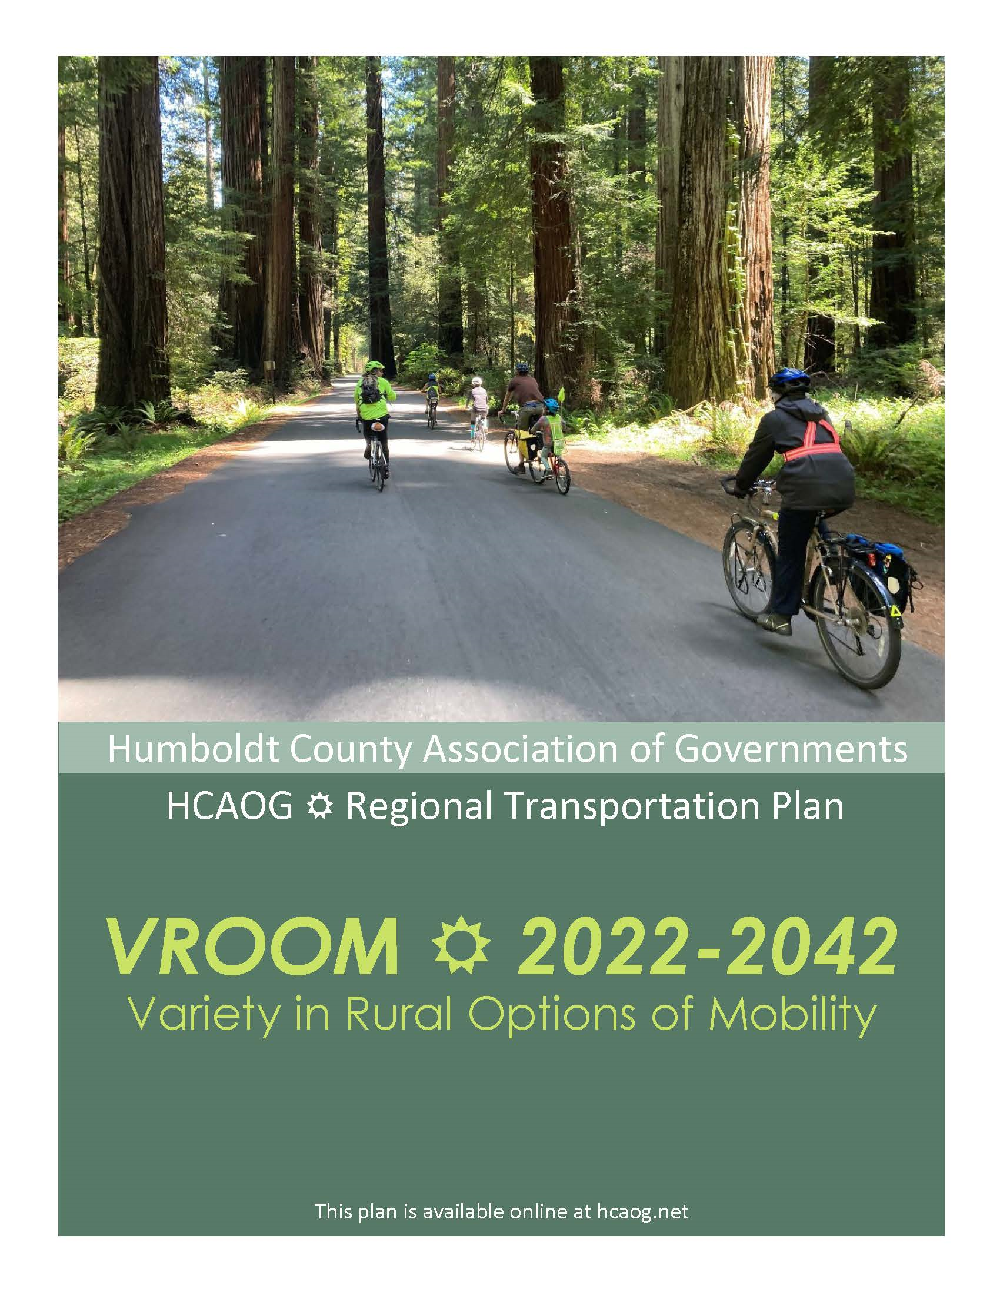
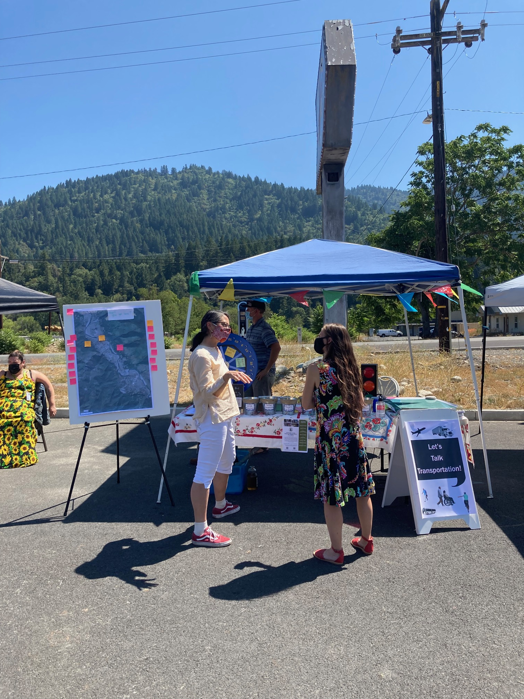
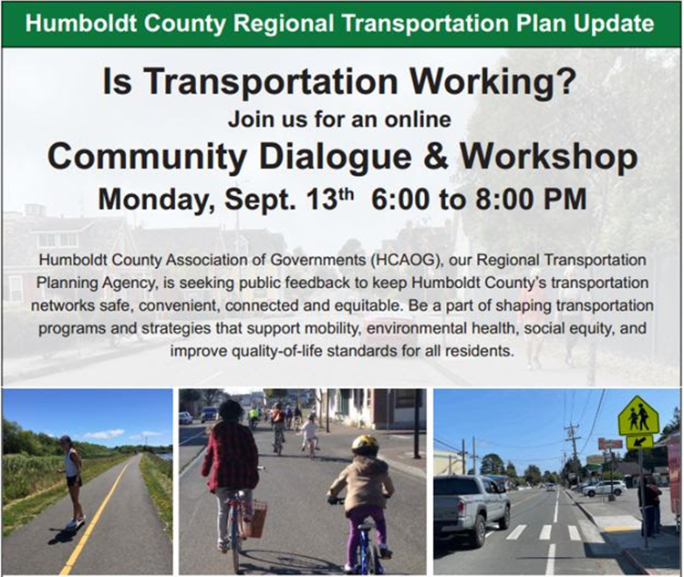
Regional Transportation Plan
Every four years
  A document that describes the current 20-year vision of transportation for the region.
Notes:
Our Most Important Plan. Like our General Plan, where we work with the community, our Technial Advisory Committee and our board to set a vision for our regional transportation network. It gets updated every 4 years.
It is our chance to be aspirational. We put policies and projects in the plan that will help us be advocates for good transportation planning, and attract dollars for regionally important projects and issues.

Slide 13
Transit Planning
Transit Development Plan (TDP) - every five years
Triennial Performance Audits- every three years
    Unmet Transit Needs Report of Findings - every year
    Coordinated Public Transit-Human Services Transportation Plan - every five years
Notes:
Transit Development Plan (TDP) - every five years
A planning document to assess transit and related transportation issues in the county and provide a “road map” for improvements to the public transit program over the upcoming five years.
Triennial Performance Audits- every three years
Focuses on issues of management, training, operations, dispatch
A triennial audit that evaluates the efficiency, effectiveness, and economy of the operation of HCAOG and transit operators that are direct recipients of TDA funds.
Unmet Transit Needs Report of Findings - every year
Documents the annual process for collecting public input on transit and paratransit needs within the region.
Coordinated Public Transit-Human Services Transportation Plan - every five years
Identifies the local transportation needs of seniors and individuals with disabilities, and prioritizes strategies to help meet those needs.

Slide 14
Operational Plans
Overall Work Program (OWP) and Budget- every year
Fiscal and Compliance Audits- every year
Public Participation Plan- every three years
Title VI and Limited English Proficiency (LEP) Plan –every three years
Notes:
Overall Work Program (OWP) and Budget - every year
A document describing all planning activities for specific transportation planning and project activities to be accomplished during the state fiscal year.
Fiscal and Compliance Audits - every year
HCAOG is required to submit a report of an audit of its accounts and records by a certified public accountant to the State Controller’s Office (SCO) every year. HCAOG also ensures that fiscal and compliance audits of all TDA claimants are submitted to the State Controller’s Office to ensure that funds TDA funds were in conformance with TDA law.
Public Participation Plan - every three years
A guiding document that establishes the process by which the public can participate in the development of regional transportation plans and federal programs.
Title VI Program and Limited English Proficiency (LEP) Plan - every three years
A document prepared to ensuring nondiscrimination under Title VI of the 1964 Civil Rights Act in federally funded activities. It ensures that the level and quality of HCAOG’s planning services are provided in a nondiscriminatory manner and that the opportunity for full and fair participation is offered to the community.

Slide 15
Infrastructure/ Project Plans
Pavement Management Plan- every four years
Regional Transportation Improvement Plan – every two years
Notes:
Regional Transportation Improvement Plan (RTIP) - every two years
A prioritized program of projects on highways, local streets and roads, transit, or bicycle and pedestrian facilities. HCAOG receives target funding amounts in August of each odd numbered year. The RTIP composes 75% of the funding to the State Transportation Improvement Program (STIP). The other 25% is programmed by Caltrans through their Interregional Transportation Improvement Program (ITIP).
Pavement Management Program (PMP) - every four years
Reports analyzing and planning the maintenance and repair of a network of roadways or other paved facilities in order to optimize pavement conditions over the entire network.

Slide 16
Other Plans
McKinleyville Transit Study
Broadway Multimodal Corridor Plan
Bike Plan
Pedestrian Plan

Slide 17
Regional Housing Needs Allocation- every 8 years
The California Department of Housing and Community Development identifies the number of housing units needed across all income levels for the region.
Working with local government staff, and the public, HCAOG develops a methodology to distribute to each local government a fair share of the total number of housing units the cities and county need to plan.
Once a local government has received its final RHNA from HCAOG, it must revise the Housing Element under its general plan to accommodate the updated portion of the region's housing need. Cities and counties are also required to report their progress to HCD annually.
Notes:
Current plan goes through 2027

Slide 18
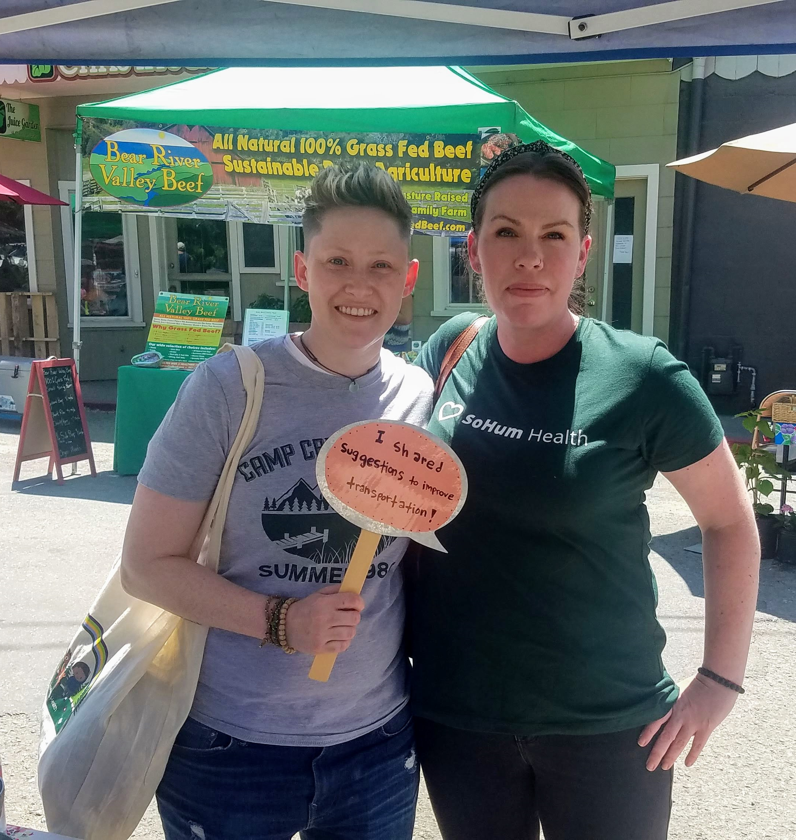
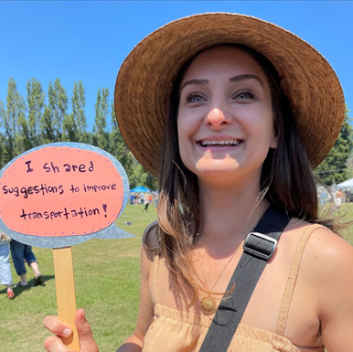
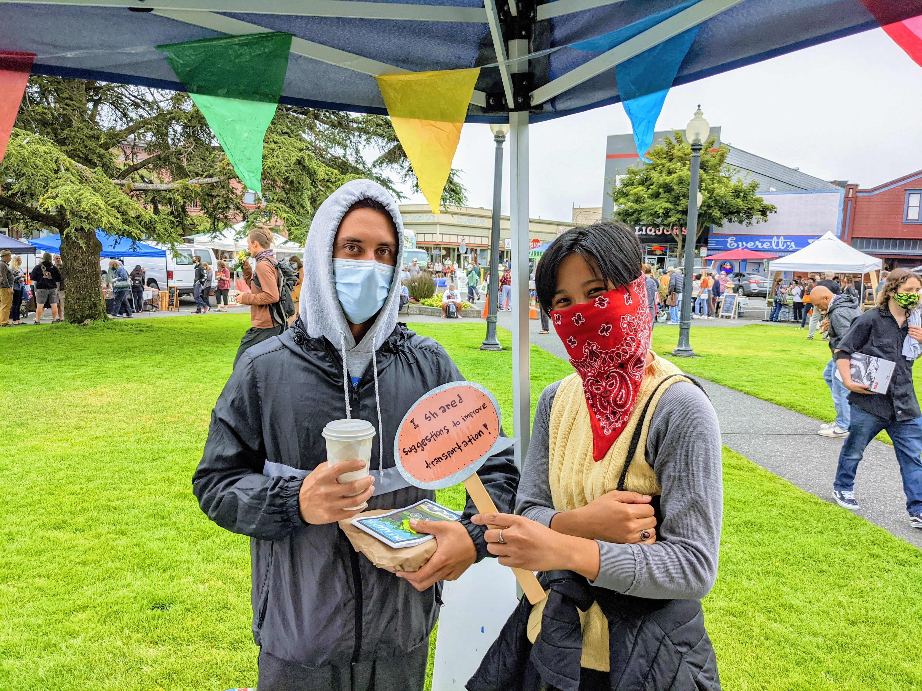
Notes:
Our Most Important Plan. Like our General Plan, where we work with the community, our Technial Advisory Committee and our board to set a vision for our regional transportation network. It gets updated every 4 years.
It is our chance to be aspirational. We put policies and projects in the plan that will help us be advocates for good transportation planning, and attract dollars for regionally important projects and issues.

Slide 19

Transportation planning: What’s important?
Core Areas of Focus
Housing &Vibrant
Neighborhoods
Safety &
Health
Equity &
Relationship
Building
Climate
Change
*Bringing more funds to Humboldt County through Infrastructure Investment and Jobs Act and other funding opportunities*
This Photo by Unknown Author is licensed under CC BY-SA
Notes:
We are full steam ahead for 2022. With the RTP adopted we have a lot to focus on. In addition to completing our fiduciary duties to keep the funds flowing, Consistent with the RTP we have core focus areas of climate change, housing and vibrant neighborhoods, safety and health, and equity and relationship building. These are all interrelated.
And we are ever seeking to build relationships. Part of that is just what I am doing now. Spreading the word about what HCAOG is up to a broader audience.
And finally- a big focus of what we do is to bring $ to our communities. Documenting our local goals and objectives in our Regional Transportation Plan is a building block to funding that we, and our member jurisdictions and other partners may go after. When its here we can show that it meets regional objectives. The state is basing a lot of funding to combine

Slide 20
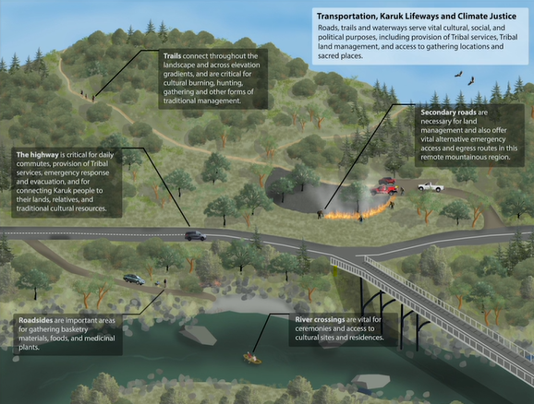
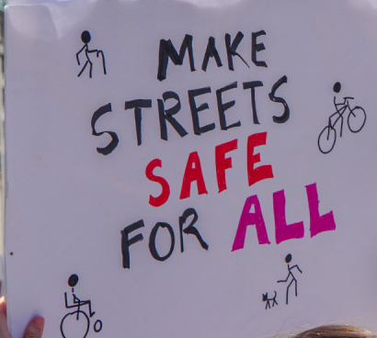
Equity
Talking Roads: Transportation and Climate Adaptation in Karuk Country
https://vimeo.com/678308904
This Photo by Unknown Author is licensed under CC BY-NC
Notes:
Equity and Relationship Building- This is infused into all we do. Transportation and land use practices in the US have contributed to systemic race-based discrimination and inequality on many levels.
We have to acknowledge that the development of our transportation network locally and at the state and national level has caused irreparable harms to native peoples and other communities of color. Locally many of our tribal nations saw severely negative impacts associated with lands being acquired for the highway system. Locally many tribal lands were impacted by highway building, forcing them to give up sovereign lands for public right of way, and resulted in freeways dividing their communities
We look to build enduring relationships with those who have been negatively impacted and those who are underrepresented in our decision making so as not to repeat the harms of the past, and remedy them when possible. We work closely with many of our local tribal nations who sit on our Technical Advisory Committee. These are relationships we take very seriously and spend a lot of time cultivating. Talking Roads: Transportation and Climate Adaptation in Karuk Country amazing overview of the intersections between tribal/ rural/ transportation/ climate change/hazard mitigation issues.
The massive investment in our road network that favors cars disproportionately benefits those who are wealthy enough to own a reliable vehicle. So our biggest community infrastructure investment is not benefitting our community equally. This has created an unsafe situation that disproportionately burdens those with disabilities, people of color, and those with lower incomes. People with lower incomes and people of color are disproportionality killed and injured as pedestrians, because they make up more of the pedestrian population. But we continue to design and maintain streetscapes that favor safety and efficiency for those in vehicles. This has to change if we are to achieve equity.

Slide 21
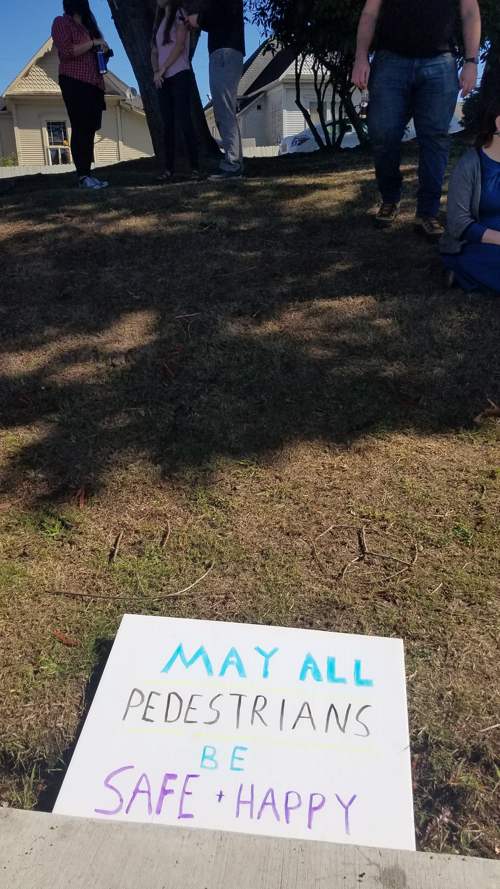

Safety/ Health
TYPE OF CRASH | VICTIMS KILLED & INJURED | County OTS RANKING | Eureka | Arcata | Fortuna | Blue Lake | Rio Dell | Trinidad
Pedestrians | 70 | 1/58 | 2/97 | 8/102 | 79/102 | 19/32 | 33/75 | 9/32
Source: 2018 CA Office of Traffic Safety
Notes:
Safety and health- this is a big one for us. We can’t talk about equity without talking about safety.
Pedestrian and bicyclists are the most vulnerable road users. There have been years and years of improvements making it safer to drive a vehicle or be a passenger in a vehicle. All the while the rates of pedestrian fatalities have skyrocketed. This is true across the nation, but especially here in Humboldt County where many years we are among the top 3 most dangerous counties in California to be a pedestrian. If we want to encourage active transportation we need to make sure our transportation network is safe.
2018: Humboldt County is the least safe county in California to be a pedestrian. Ranking number 1 for pedestrians killed or injured.
The data on the slide were from 2018, 2020 data has been recently released and at this point HumCo ranks 2nd in all 58 counties for pedestrian deaths/injuries
From 2005-2019 38% of the pedestrian fatalities in Humboldt were people of color, while they only make up 21% of the population.
Making streets safe for all users is a priority and we include policies towards a vision of zero traffic fatalities and pedestrian deaths. All deaths and severe injuries are unacceptable.

Slide 22
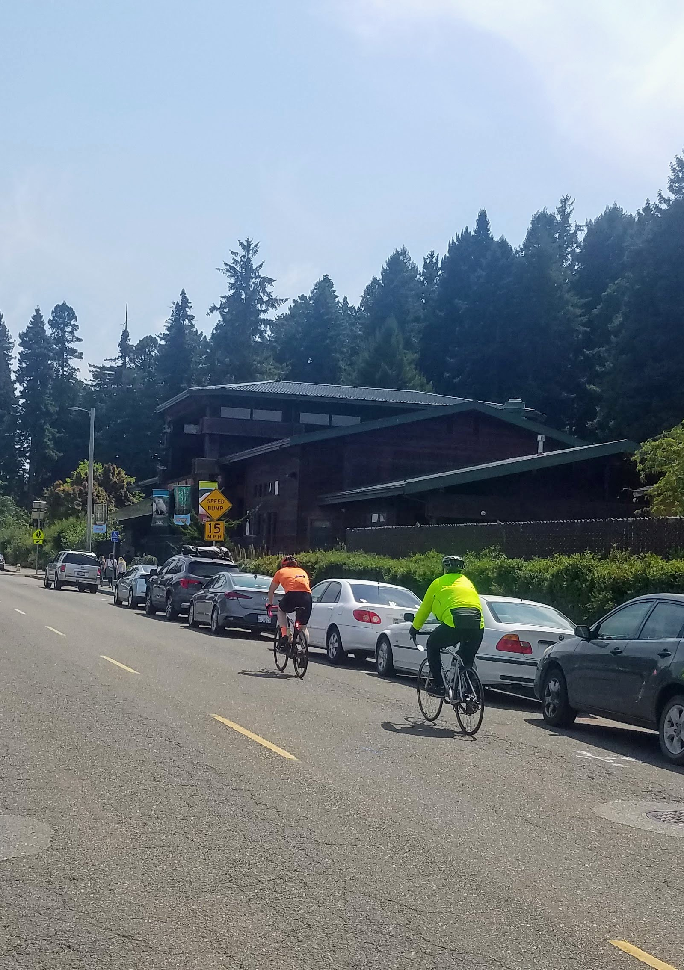
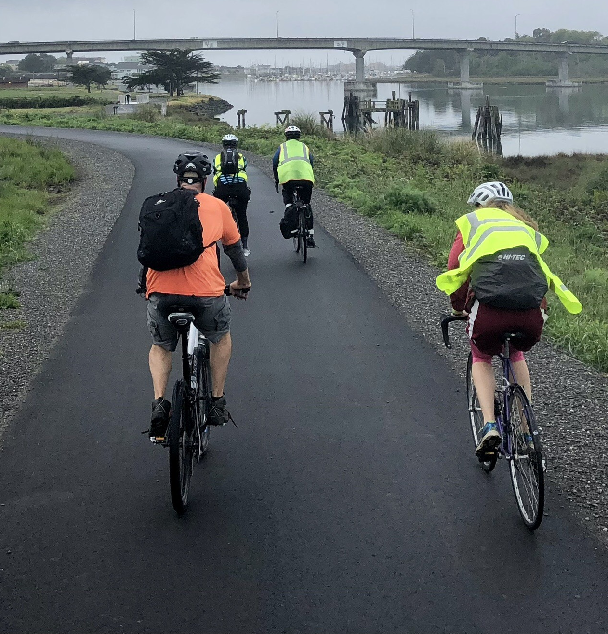
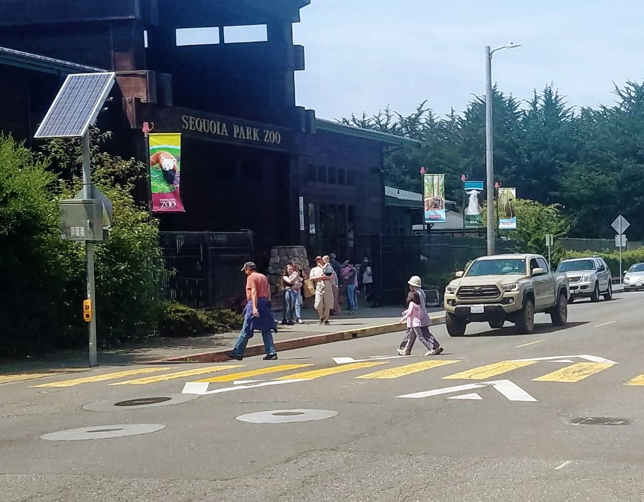
Health/ Active Transportation
Notes:
Health benefits of active transportation-
Communities that prioritize active transportation tend to be healthier by enabling residents to be more physically active in their daily routines and by having cleaner air to breathe.
What is active transportation in public health?
Promote Active Transportation. Active transportation is any self-propelled, human-powered mode of transportation, such as walking or bicycling. Physical inactivity is a major contributor to the steady rise in rates of obesity, diabetes, heart disease, stroke, and other chronic health conditions in the United States.
The Mobility Factor
Active transportation also gives people who cannot drive more options for getting around independently. Those who benefit most include children (particularly for travel to and from school), seniors and those with disabilities, and people with low income. Increasing transportation options also benefits drivers by decreasing congestion and demand for parking, as people choose to walk or bike instead.
Crash rankings are based on the Empirical Bayesian Ranking Method, which adds weights to different statistical categories including observed crash counts, population and vehicle miles traveled. The crash counts reflect the aggregated impacts of all influential factors containing even the unrecognized or unmeasurable ones (e.g. level of enforcement), and the population and vehicle miles traveled represent the important traffic exposure factors that affect crash occurrence. The weights are assigned to the three components in a way that maximizes the precision of estimated Bayesian crash counts.
Active transportation is a huge focus of our RTP, we seek to promote active transportation as advocates. It relates to all our focus areas.
We need safer streets to promote active transportation
We need to develop housing in walkable/ ridable communities to promote active transportation and better health outcomes. ‘
By increasing active transportation we can help reduce our greenhouse gas emissions and meet our climate change goals.
Active transportation increases equity by allowing all users to safely navigate the road and trail system.

Slide 23
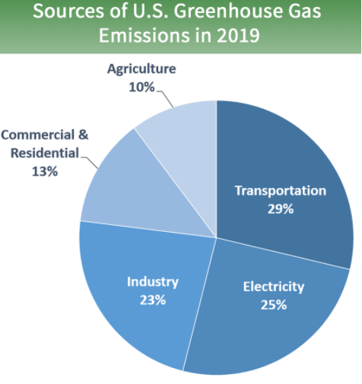
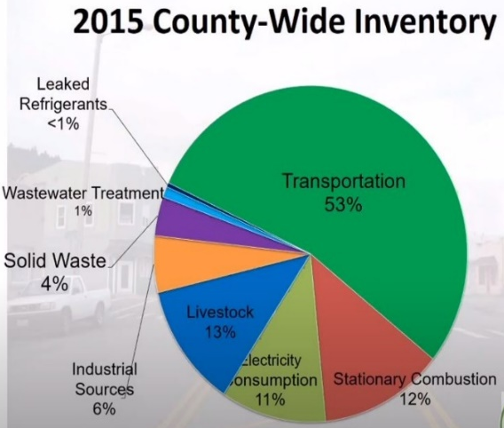
Addressing Climate Change
Notes:
Transportation sector is the single biggest contributor to GHG emissions nationwide. In Humboldt County this is even more true.
Climate Change- in Humboldt County the transportation sector accounts for 53% of our greenhouse gas emissions. (Draft County CAP 2015). So as the regional transportation agency we are working towards promoting carbon neutral transportation methods- transit, walking, biking, and zero emission vehicles. We also have climate adaptation and resiliency on our minds as we have some critical transportation infrastructure that will be subject to sea level rise and increased wildfire hazard risk.

Slide 24
Addressing Climate Change- Safe and Sustainable Transportation Targets
Mode shift to from individual vehicles to active and transit ridership
Invest in complete streets
Active transportation education
Vision Zero (towards zero traffic and pedestrian deaths)
Convenient access to destinations
Efficiency in locating new housing
Increase Zero Emission fleets and EV charging infrastructure
Reduce Vehicle Miles Traveled by car
Notes:
With each of these targets there are specific percentages and identified data sources. This will be our first attempt at trying to quantify our results.
Transit: A lot of good work here about exploring more on-demand versus fixed route transit programs which have shown to be especially viable in areas without high density housing,
A lot of technology advances, looking at easy ways to pay, apps that provide real time data on scheduling and arrivals,

Slide 25
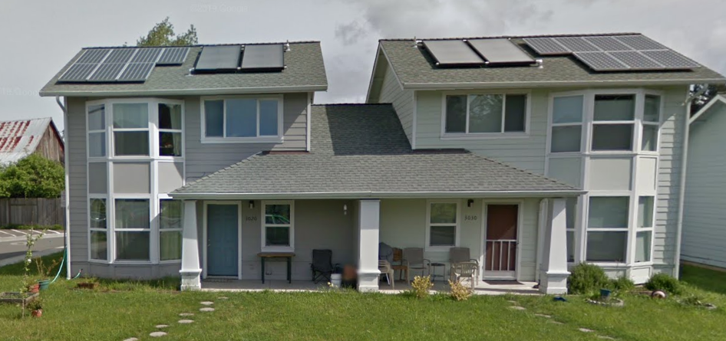
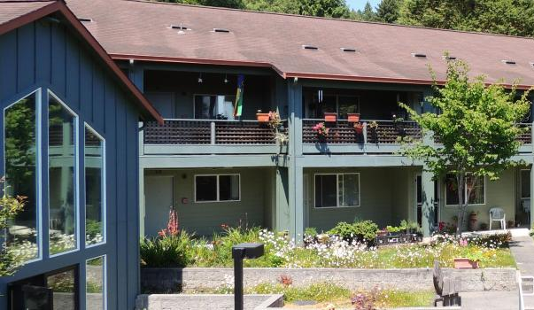
Housing and Vibrant Neighborhoods
Notes:
Housing and vibrant neighborhoods. This is a newer core area of focus. For the first time we have a land-use and transportation chapter in our Regional Transportation Plan. Our policies have encouraged us to look a lot more closely at our land use patterns in terms of how they dictate our transportation choices.
What we need to see in terms of housing is a level of density and mixed use developments that support a range of transportation options. We are interested in less car dependent development if we are going to achieve the other goals we have related to climate, safety, and equity. We have a lot of policies to support mode shift out of cars and to other modes of transportation and to reduce vehicle miles travelled.
How do we do this?? HCAOG does not have any land use authority, we have no codes or ordinances our member agencies are obligated to follow. So we do this primarily through relationship building, information sharing. We track major projects and plans and compare them to the outcomes we are targeting. We make comments often in favor of projects that have components that will achieve our objectives, what could be added to projects to get them closer and point out when a project will have the opposite effect. Some of the projects we are currently tracking are the McKinleyville Town Center, and Arcata’s Gateway plan.
Some key policies we have are to promote the 20 or 30 minute city in which you could get to most of your essential destinations without getting in a car within 20 to 30 minutes
We are going to be looking comprehensively at level of traffic stress. –which measures where it is most comfortable and uncomfortable to be a pedestrian or cyclists. If people don’t feel safe they won’t choose these modes. Then we can highlight with an equity overlay where to make improvements to lower the stress and conflicts and do projects that make it more appealing to chose a different mode especially in areas that are underinvested

Slide 26
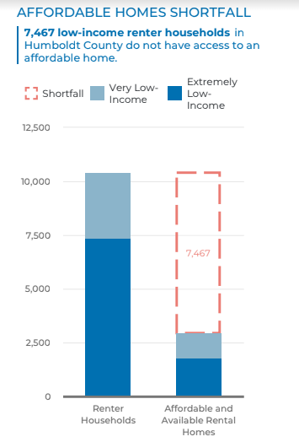
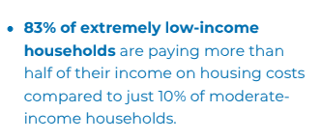
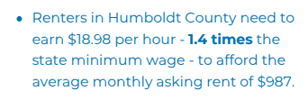
Image and data from: California Housing Partnership, Humboldt County 2021 Affordable Housing Needs Report
This Photo by Unknown Author is licensed under CC BY-SA
Notes:
More efficient development also contributes to more affordability. (infill, reduced parking standards, proximity to transit and ability safely participate in active transportation). Many in our community are rent over-burdened. And it is also very expensive to own a car. Making sure you don’t need a car to live is a cost savings. So is developing in a way that does not require expanding infrastructure and a lot of parking makes it cheaper to build units.

Slide 27
REAP
Regional Early Action Planning
(Housing)
Art/ Multimedia catalogue:
  “I am your neighbor” Comic book illustrating an individual’s experience with homelessness
  “ A Women’s Place is in her Home” Arcata Playhouse
  “Homebound –a Comprehensive Loot at Affordable Housing in Blue Lake” – Videography exploring challenges of securing housing in Blue Lake
This Photo by Unknown Author is licensed under CC BY-SA
Notes:
Novel effort- Want to discuss REAP is grant funds for regional housing efforts. There is a lot of public outreach as part of this funding and one of the things we are supporting is the development of a multimedia catalogue- art based ways to raise awareness of our housing crisis.
Artists are in production now.

Slide 28
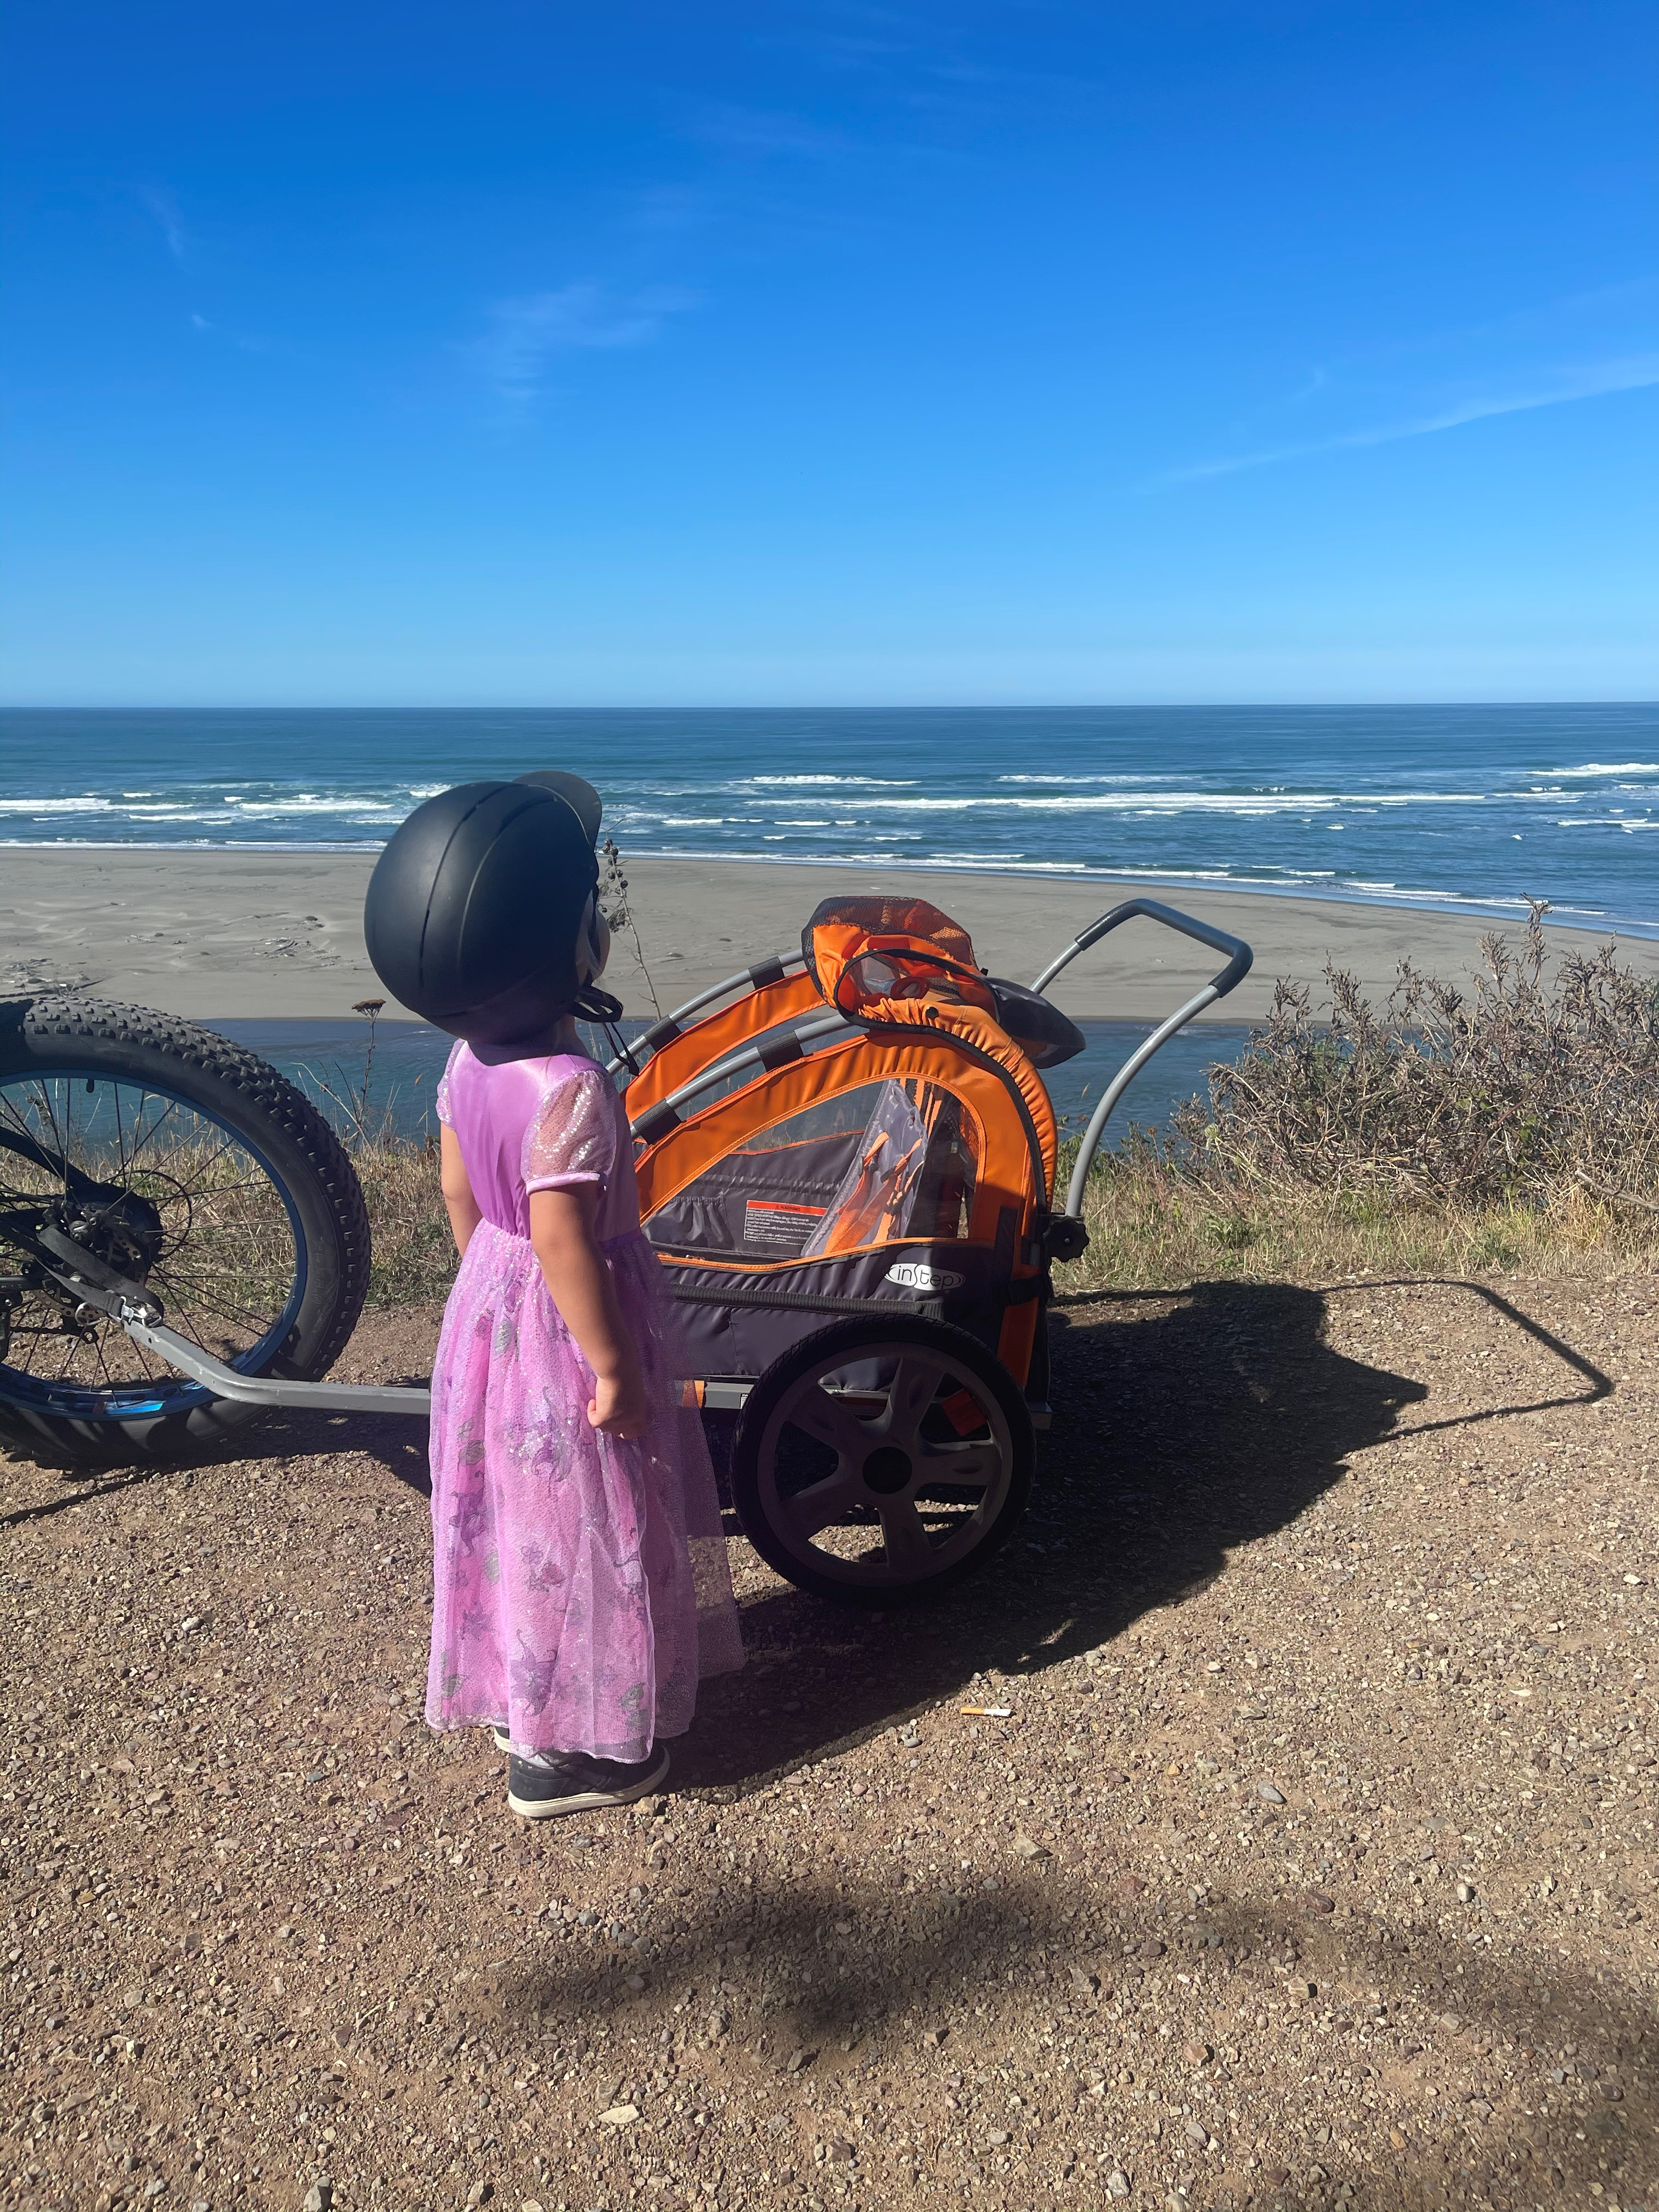
Thank you!
Beth Burks, AICP
HCAOG Executive Director
Beth.burks@hcaog.net
707-444-8208

