Slide 1
Public Records request to Caltrans produced as-built plans for 1962 freeway construction near trinidad
p.1/7

Slide 2
Tribal land on west side of freeway-site of current rancheria/ casino.
Tribal land on east side of freeway-one acre
N
Indian Agency
Adjacent land to new highway construction-one acre on east was severed from bulk of land on west
(source: Caltrans 1962 freeway as-built plans)
p.2/7

Slide 3
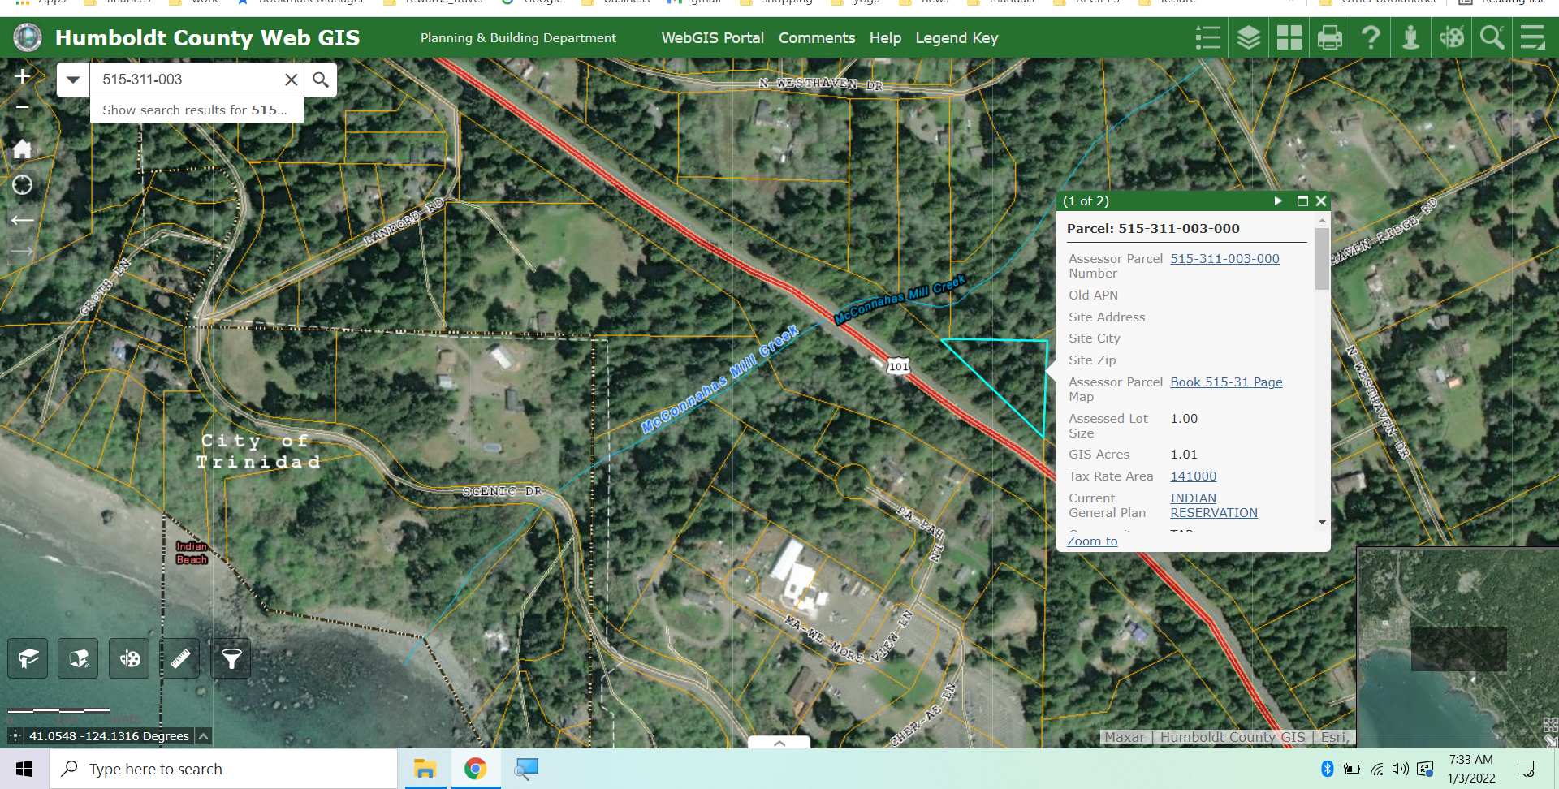
N
N
N
Triangular piece on east side of freeway is one acre ( source: humboldt county gis)
p.3/7

Slide 4
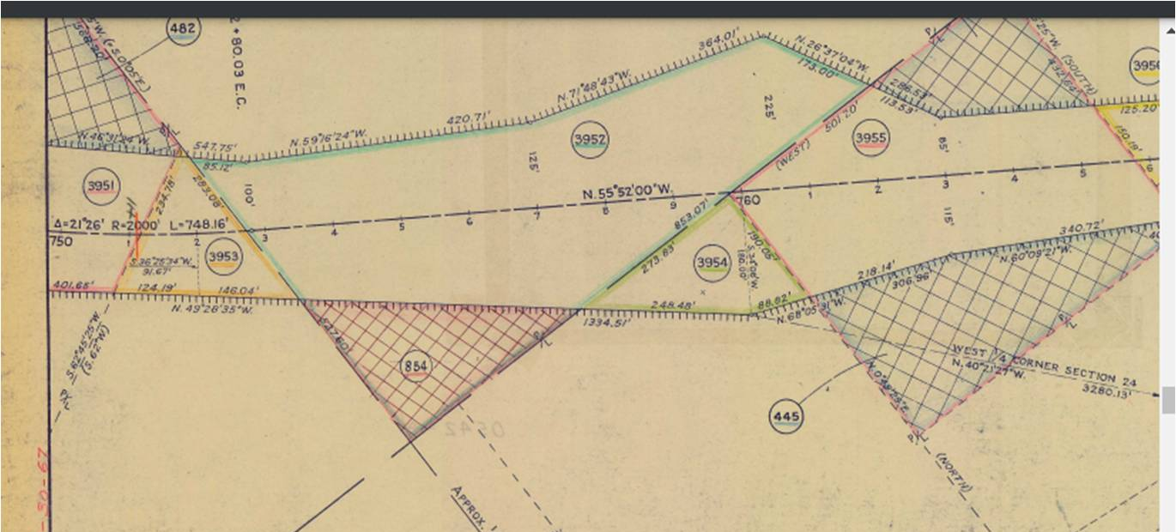
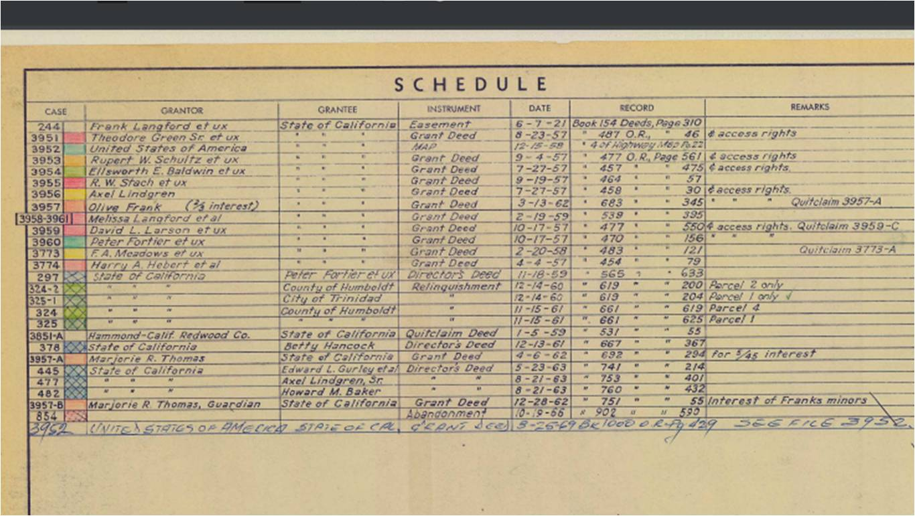
The triangular piece on the east side of the freeway was abandoned 1966.
(source; Caltrans right of way maps)
Schedule includes reference to recorded document in county recorders office
Note engineering stations match as-built plans exactly
N
p.4/7

Slide 5
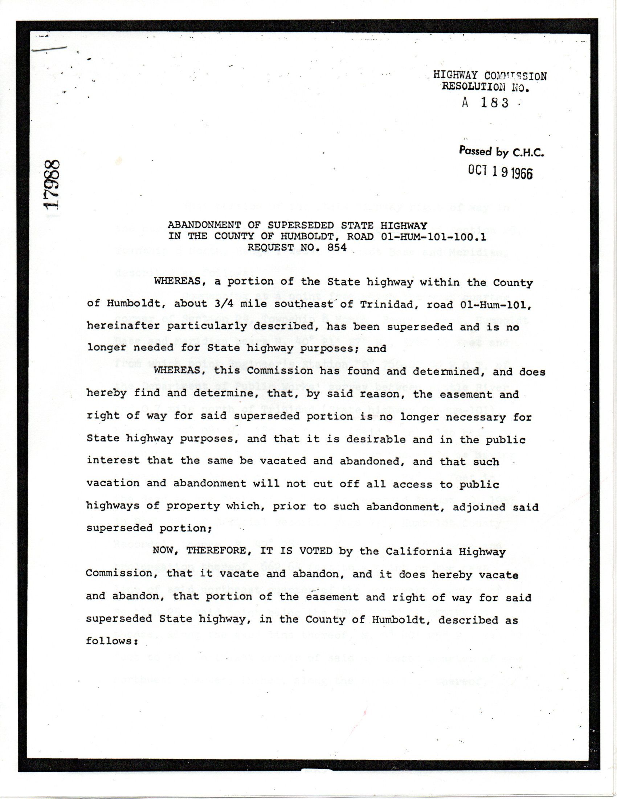
Abandonment document dated 10/19/1966
from Humboldt county recorders office
(p.1/4)
p.5/7

Slide 6
From introduction (p.1)
The Trinidad Rancheria is now comprised of three separate parcels that total 82 acres. The largest parcel is located on the west side of Highway 101 along the Pacific Coast and is made up of 46.5 acres. This parcel accommodates Tribal Member Housing, Tribal Offices, a Tribal Library, the Cher-Ae Heights Casino and the Sunset Restaurant. Approximately 8 acres were purchased in Westhaven, directly across Highway 101 in the late 1980s and a third 27.5 acre parcel, located in the unincorporated community of McKinleyville, was purchased in the 1990s and now houses 12 residential properties.
2011 Community Plan states Westhaven acreage was purchased 25 years after freeway construction.
p.6/7

Slide 7
Original 1908 east side tribal lands
(abandoned 1966)
APN:515-311-003
Freeway constructed 1962
Source:
Humboldt County GIS,
Hum County Recorders Office
Caltrans as-built plans
N
Tribal lands presumably purchased ~1988
Current tribal residences
APNs:
515-041-074=1.73 acre
515-041-075=1.32 acre
515-041-067=4.25 acre
7.8 acre=~8 acre
p.7/7

