Slide 1
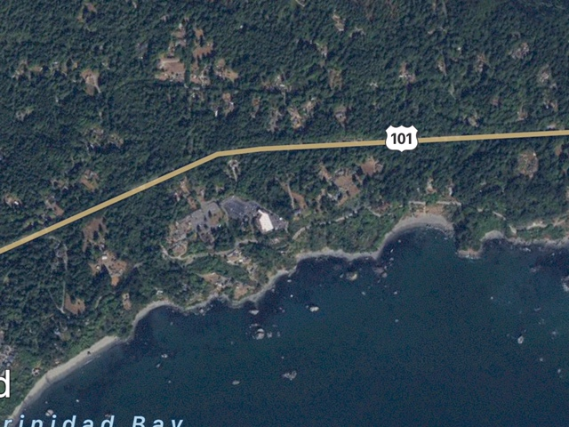
Rancheria-
N
North of rancheria- scenic dr veers inland – note many bluff homes along ocean
South of rancheria- scenic dr failing along ocean – note lack of homes on bluffs
p. 1/3

Slide 2
N
Rancheria-
North of rancheria- scenic dr veers inland – note many bluff homes along ocean
p. 2/3

Slide 3
Rancheria
N
North of rancheria- scenic dr veers inland – note many bluff homes along ocean
South of rancheria- scenic dr failing along ocean – note close proximity of scenic drive to ocean
p. 3/3

